Slide 1


Multispectral Sensors in Remote Sensing
Group Members: Pratik Kumar (25DR0173)
Antika Kuila (25MT0083)
Anirban Gayen (25MT0068)
Akash Jadhav (25MT0035)
Neeraj Yadaw (25DP0031)
Date: 7 October 2025
M.Tech in Geomatics
Department of Mining Engineering
IIT(ISM) Dhanbad

Slide 2
Multispectral Sensors
Introduction:
Multispectral sensors capture image data at specific wavelength bands across the electromagnetic spectrum.
Widely used in Earth Observation for detailed analysis of land, water, and atmospheric phenomena.
They differ from panchromatic (single band) and hyperspectral (hundreds of narrow bands) sensors.
Key Concepts:
Electromagnetic spectrum regions: Visible (VIS), Near-Infrared (NIR), Shortwave Infrared (SWIR), Thermal Infrared (TIR).
Sensor Types: Passive optical (collecting naturally reflected sunlight), active sensors (emit their own signals).

Slide 3
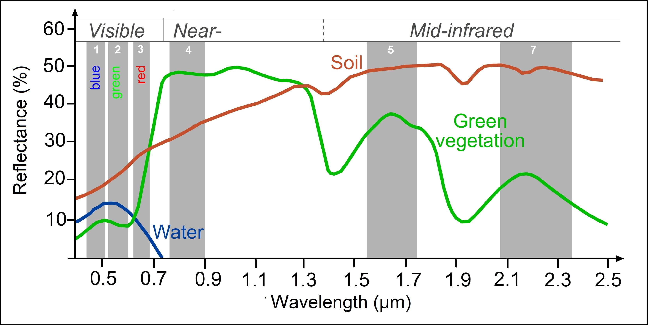
Multispectral Sensors
Scanning Mechanisms:
Whiskbroom (across-track): Uses moving mirrors; precise, but slower coverage.
Pushbroom (along-track): Linear array detects data across a swath in one go.
Important Parameters:
Spatial resolution (detail of ground features),
Spectral resolution (number/width of bands),
Temporal resolution (revisit frequency).
Spectral Reflectance Curve

Slide 4
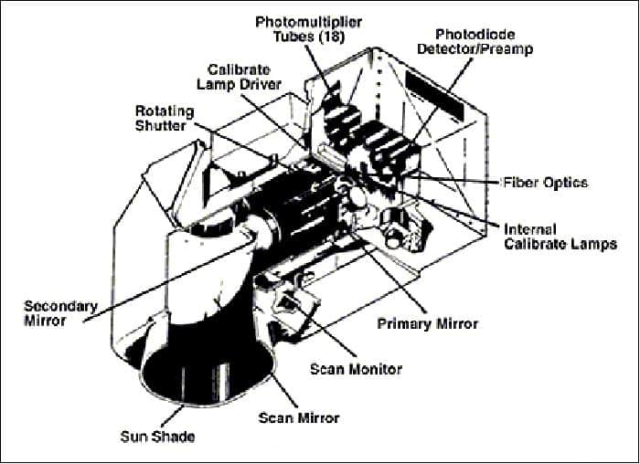
MSS: Multispectral Scanner
Satellites: Landsat 1, 2, 3, 4, 5
Agency: NASA/USGS (USA)
Launched: 1972-2013
Type: Passive OIR, Scanning-Imaging (Whiskbroom)
Spatial Resolution: 79 m (VIS/NIR), 240 m (TIR)
Spectral Resolution: 4 bands, 5 bands (for Landsat 3)
Temporal: 18 days
Radiometric: 6 bits
Swath: 185 km
Impact: Revolutionized ability to monitor large areas.
Figure: Cutaway view of the MSS (image credit: NASA)

Slide 5
MSS: Multispectral Scanner

Slide 6
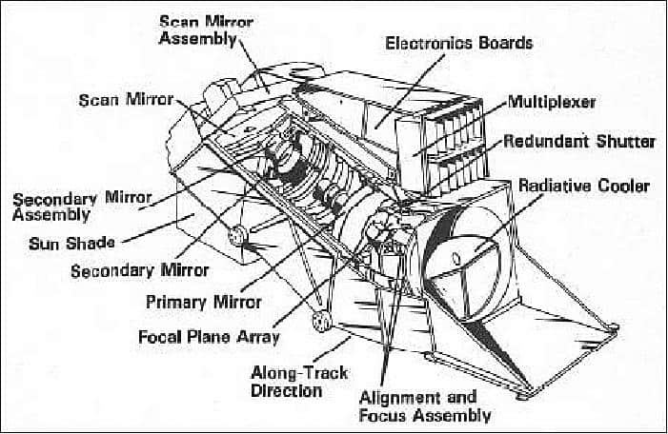
TM: Thematic Mapper
Satellites: Landsat 4, 5
Agency: NASA/USGS (USA)
Launched: 1982-2013
Type: Passive OIR, Scanning-Imaging (Whiskbroom)
Spatial Resolution: 30 m (VIS/NIR/SWIR), 120 m (TIR)
Spectral Resolution: 7 bands
Temporal: 16 days
Radiometric: 8 bits
Swath: 185 km
Advance: Improved spatial, radiometric and spectral resolution over MSS..
Figure: Configuration of the Thematic Mapper (image credit: NASA)

Slide 7
TM: Thematic Mapper

Slide 8
ETM+: Enhanced Thematic Mapper Plus
Satellites: Landsat 7
Agency: NASA/USGS (USA)
Launched: 1999-2025
Type: Passive OIR, Scanning-Imaging (Whiskbroom)
Spatial Resolution: 30 m (VIS/NIR/SWIR), 60 m (TIR), 15 m (Pan)
Spectral Resolution: 8 bands
Temporal: 16 days
Radiometric: 8 bits
Swath: 185 km
Significance: Addition of panchromatic and coastal bands, further detail.

Slide 9
ETM+: Enhanced Thematic Mapper Plus

Slide 10
OLI: Operational Land Imager
Satellites: Landsat 8, 9
Agency: NASA/USGS (USA)
Launched: 2013-Present
Type: Passive OIR, Non Scanning-Imaging (Pushbroom)
Spatial Resolution: 30 m (MS), 15 m (Pan)
Spectral Resolution: 9 bands
Temporal: 16 days
Radiometric: 12 bits (Landsat 8), 14 bits (Landsat 9)
Swath: 185 km
Significance: Land use monitoring, water resources and coastal zone investigation, climate studies, disaster management, geological mapping.

Slide 11
OLI: Operational Land Imager

Slide 12
TIRS: Thermal Infrared Sensor
Satellites: Landsat 8, 9
Agency: NASA/USGS (USA)
Launched: 2013-Present
Type: Passive OIR, Non Scanning-Imaging (Pushbroom)
Spatial Resolution: 100 m
Spectral Resolution: 2 bands
Temporal: 16 days
Radiometric: 12 bits (Landsat 8), 14 bits (Landsat 9)
Swath: 185 km
Significance: Measures land surface temperature, provides data for water irrigation management in arid regions, and tracks urban heat units.

Slide 13
HRV: High Resolution Visible
Satellites: SPOT 1, 2, 3
Agency: CNES (France)
Launched: 1986-2009
Type: Passive OIR, Non Scanning-Imaging (Pushbroom)
Spatial Resolution: 10 m (Pan), 20 m (MS)
Spectral Resolution: 4 bands
Temporal: 26 days
Radiometric: 8 bits
Swath: 60-117 km (Combined)
Advcance: Used for land use/land cover mapping, infrastructure management, precision forestry, and military/intelligence.
Two High-Resolution Visible (HRV) imagers are used in each satellite.
They operated in two modes, Panchromatic (PAN) mode and Multispectral (MS) mode, either individually or simultaneously.

Slide 14
HRV: High Resolution Visible

Slide 15
HRVIR: High Resolution Visible and Infrared
Platform Details
Spatial Resolution
SPOT-4 Satellite (France)
Launched: March 1998
Swath Width: 60 km
Primary Uses
Vegetation discrimination and monitoring
Water body identification
Soil moisture assessment
Spatial Resolution
Multispectral: 20 meters
Panchromatic: 10 meters
Ideal for regional land use studies

Slide 16
Spectral band configuration
Band Wavelength(µm) Application
B1 (Green) 0.50–0.59 Vegetation health, water bodies
B2 (Red) 0.61–0.68 Vegetation discrimination, chlorophyll absorption
B3 (NIR) 0.79–0.89 Biomass estimation, vegetation vigour
SWIR 1.58–1.75 Soil moisture, geological mapping

Slide 17
NAOMI
NAOMI: New AstroSat Optical Modular Imager
NAOMI represents the latest advancement in high-resolution Earth observation, serving as the successor to ALOS AVNIR-2. Deployed on Japan's ALOS-3 platform in 2024, this push-broom scanner captures data in the visible and near-infrared spectrum with exceptional spatial detail.
With its impressive 70 km swath width and uniform 3-meter resolution across all spectral bands, NAOMI excels at detailed coastal zone mapping, urban planning applications, and precision vegetation analysis.

Slide 18
SPECTRAL BAND CONFIGURATION
0.42–0.50 µm | 3 m resolution
Coastal water penetration
NIR Band
Blue Band
0.76–0.89 µm | 3 m resolution
Biomass and structure
GREEN BAND
0.52–0.60 µm | 3 m resolution
Vegetation peak reflectance
RED BAND
0.61–0.69 µm | 3 m resolution
Chlorophyll absorption

Slide 19
MODIS
MODIS: Moderate Resolution Imaging Spectroradiometer
PLATFORM
COVERAGE
Terra Satellite (1999)
Aqua Satellite (2002)
NASA Earth Observing System
Resolution
250 m (Bands 1-2)
500 m (Bands 3-7)
1000 m (Bands 8-36)
Swath: 2,330 km
Global coverage every 1-2 days
36 spectral bands

Slide 20
MODIS
APPLICATION
Vegetation Monitoring
NDVI and EVI products track global vegetation dynamics and phenology patterns
Ocean Color
Chlorophyll concentration and phytoplankton distribution in marine ecosystems
Land Surface Temperature
Day and night LST measurements for climate and urban heat island studies
Atmospheric Science
Cloud properties, aerosols, and atmospheric correction parameters

Slide 21
ASTER
ASTER: Advanced Spaceborne Thermal Emission and Reflection Radiometer
ASTER (Advanced Spaceborne Thermal Emission and Reflection Radiometer) is a high spatial resolution imaging instrument aboard NASA's Terra satellite, launched in December 1999 as part of NASA's Earth Observing System (EOS).
It provides detailed Earth imagery across 14 spectral bands spanning visible, near-infrared, shortwave infrared, and thermal infrared wavelengths, ranging from 0.52 µm to 11.65 µm. ASTER enables the creation of high-resolution maps of surface temperature, emissivity, and reflectance, and adds stereo viewing capability for Digital Elevation Model (DEM) generation.

Slide 22
ASTER
ASTER: Advanced Spaceborne Thermal Emission and Reflection Radiometer
SPECTRAL BAND CONFIGURATION
VNIR Subsystem
3 bands | 0.52–0.86 µm
Resolution: 15 meters
Surface reflectance, stereo DEM generation
TIR Subsystem
5 bands | 8.125–11.65 µm
Resolution: 90 meters
Land surface temperature, volcanic activity
SWIR Subsystem
6 bands | 1.6–2.43 µm
Resolution: 30 meters
Mineral identification, lithological mapping

Slide 23
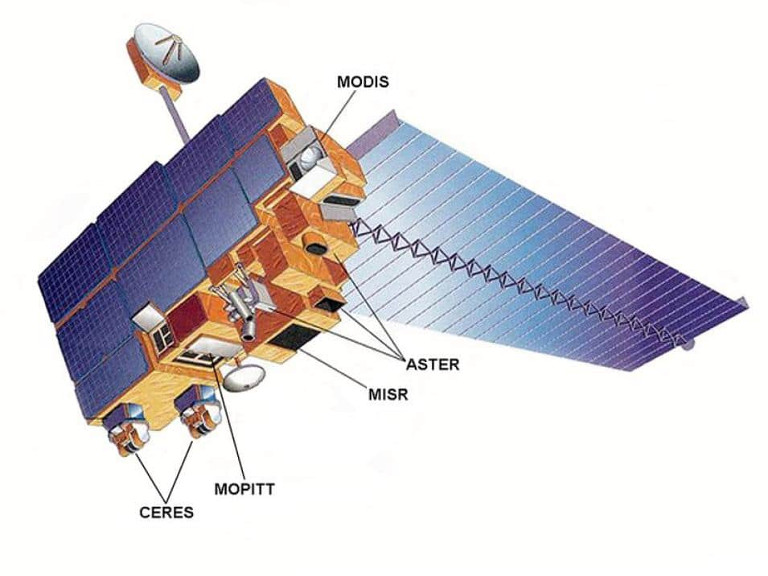
Terra spacecraft showing the locations of its five instruments.

Slide 24
AVHRR
AVHRR: Advanced Very High Resolution Radiometer
Operating continuously since 1978 on NOAA's polar-orbiting satellite series, AVHRR provides one of the longest records of Earth observation data. This heritage sensor has been instrumental in establishing baseline climate measurements and long-term vegetation trends with its 1.1 km spatial resolution and twice-daily global coverage.

Slide 25
AVHRR
AVHRR: Advanced Very High Resolution Radiometer
Spectral Band Configuration
Band | Wavelength (µm) | Primary Application
1 | 0.58–0.68 | Cloud detection, surface mapping, vegetation discrimination
2 | 0.73–1.10 | Vegetation indices (NDVI), biomass assessment
3A | 1.58–1.64 | Snow/ice discrimination, daytime cloud detection
3B | 3.55–3.93 | Night cloud temperature, fire detection
4 | 10.30–11.30 | Sea surface temperature (SST), land surface temperature (LST)
5 | 11.50–12.50 | Atmospheric water vapor correction, split-window SST

Slide 26
MERIS
MERIS: Medium Resolution Imaging Spectrometer
Operating on ESA's ENVISAT platform from 2002 to 2012, MERIS was specifically designed for ocean colour remote sensing with 15 programmable spectral bands in the visible and near-infrared range (0.39–1.04 µm).
With its exceptional 1,150 km swath width, MERIS achieved global coverage every 2-3 days, making it invaluable for monitoring dynamic ocean processes, coastal water quality, and terrestrial ecosystems.

Slide 27
MERIS
MERIS: Medium Resolution Imaging Spectrometer
Application
Ocean Colour Products: Chlorophyll a concentration, suspended sediment, and colored dissolved organic matter (CDOM) measurements enable marine ecosystem health assessment
Water Quality Monitoring: Algal bloom detection, turbidity mapping, and eutrophication assessment in coastal and inland waters
Atmospheric Correction: Dedicated bands for aerosol and water vapor retrieval ensure accurate surface reflectance products
Coastal Zone Studies: 300 m full resolution mode enables detailed monitoring of dynamic coastal ecosystems and land-sea interactions

Slide 28
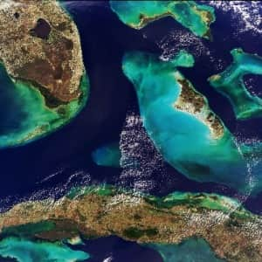
MERIS
MERIS: Medium Resolution Imaging Spectrometer
Bahamas, captured by MERIS on 24 Jan 2004

Slide 29
OSA : Optical Sensor Assembly
Platform Details
Spatial Resolution
Multispectral: 3.28 meters
Panchromatic: 0.82 meters
Ideal for urban planning and management
IKONOS-2(USA)
Launched: September 1999
Decommissioned: March 2015
Swath Width: 11.3 km at Nadir
Primary Uses
Urban planning and management
and Land use and land cover mapping
Monitoring of open-pit mines

Slide 30
Spectral band configuration
Band Wavelength(µm) Application
Panchromatic 0.45 – 0.90 Used for high-resolution mapping (up to 1 meter)
Blue 0.45 – 0.52 Useful in coastal zone studies, Water body delineation
Green 0.52 – 0.60 Supports forestry analysis and urban green space mapping
Red 0.63 – 0.70 Identifies vegetation species, land cover classification
NIR 0.76 – 0.90 Vegetation health assessment, biomass estimation

Slide 31
QuickBird
Platform Details
Spatial Resolution
QuickBird(USA)
Launched: October 2001
Decommissioned: January 2015
Swath Width: 16.8 km
Primary Uses
Environmental monitoring and Natural resource exploration
Disaster management and emergency response
Multispectral: 2.90 meters
Panchromatic: 0.65 meters
Ideal for high-resolution earth observation

Slide 32
SPECTRAL BAND CONFIGURATION
Band Wavelength(µm) Application
Panchromatic 0.45 – 0.90 Urban infrastructure delineation and monitoring
Blue 0.45 – 0.52 Soil and vegetation discrimination
Green 0.52 – 0.60 Forest cover and biomass estimation
Red 0.63 – 0.70 Land cover classification and soil discrimination
NIR 0.76 – 0.90 Water body boundaries and sediment detection

Slide 33
WorldView-2
Platform Details
Spatial Resolution
Multispectral: 1.84 meters
Panchromatic: 0.46 meters
Ideal for high-resolution urban planning and infrastructure monitoring, road networks, buildings, and utilities
WorldView-2(USA)
Launched: October 2009
Swath Width: 16.4 km
Primary Uses
Generation of Digital Terrain Models and Crop monitoring and yield forecasting
Forest inventory and forest management

Slide 34
SPECTRAL BAND CONFIGURATION
Band Wavelength(µm) Application
Panchromatic 0.45 – 0.80 High-resolution grayscale imagery for detailed mapping
Coastal 0.40 – 0.45 Coastal and shallow water bathymetry mapping
Blue 0.45 – 0.52 Soil and vegetation discrimination
Green 0.52 – 0.60 Forest cover and biomass estimation
Yellow 0.58 – 0.62 Crop maturity and stress monitoring
Red 0.63 – 0.70 Land cover classification and soil discrimination
Red-edge 0.70 – 0.74 Sensitive to chlorophyll content for crop health
NIR 1 0.77 – 0.89 Vegetation biomass and health monitoring
NIR2 0.86 – 1.04 Enhanced vegetation discrimination and biomass assessment

Slide 35
WorldView-3
Platform Details
Spatial Resolution
Multispectral: 1.24 meters
SWIR: 3.7meters
CAVIS: 30 meters
Panchromatic: 0.31 meters
Precise environmental and atmospheric monitoring
WorldView-3(USA)
Launched: August 2014
Swath Width: 13.1 km
Primary Uses
Environmental monitoring and Mineral and geological mapping enabled by SWIR bands
CAVIS sensor bands that monitor clouds, aerosols, vapors, ice, and snow

Slide 36
SPECTRAL BAND CONFIGURATION
Panchromatic Band (0.45 – 0.80 µm)
High-resolution black-and-white imagery for detailed mapping and feature extraction.
Urban infrastructure and road network analysis
Multispectral Bands (0.40 – 1.04 µm)
Soil and Moisture Analysis
Vegetation Monitoring Land Cover Classification
Urban Mapping
Disaster Assessment
Shortwave Infrared (SWIR) Bands (1.19 - 2.36 µm)
Mineral identification and geological mapping
Burn scar and fire damage analysis
CAVIS Bands (12 bands)
Atmosphere and cloud monitoring, Aerosol and vapor detection for image correction
and snow and ice monitoring

Slide 37
WorldView-4
Platform Details
Spatial Resolution
Multispectral: 1.24 meters
Panchromatic: 0.31 meters
WorldView-4(USA)
Launched: January 2019
Swath Width: 13.1 km
Primary Uses
Engineering surveys especially for construction and oil and gas facilities and Detailed urban and infrastructure mapping
Disaster response and recovery assessment

Slide 38
SPECTRAL BAND CONFIGURATION
Band Wavelength(µm) Application
Panchromatic 0.45 - 0.80 High-resolution detailed mapping and feature extraction
Blue 0.45 - 0.51 Water body delineation and sediment analysis
Green 0.51 - 0.58 Crop monitoring and species differentiation
Red 0.65 - 0.69 Soil and land cover classification
NIR 0.78 - 0.92 Water body boundaries and wetland mapping

Slide 39
RapidEye
Platform Details
Spatial Resolution
5 meters Orthorectified
RapidEye (USA)
Launched: August 2008
Decommissioned: April 2020
Swath Width: 77 km
Primary Uses
Disaster Management and Mapping and Cartography
Land and Agriculture Monitoring

Slide 40
SPECTRAL BAND CONFIGURATION
Band Wavelength(µm) Application
Blue 0.44 – 0.51 Water body analysis including clarity and quality assessment
Green 0.52 – 0.59 Urban greenery mapping and land cover classification
Red 0.630 – 0.68 Identifying vegetation species and soil mapping
Red-edge 0.69 – 0.73 Differentiation of vegetation species and health
NIR 0.76 – 0.85 Forest inventory and canopy analysis

Slide 41
Sensor Type: Passive Optical Agencies: ESA (European Space Agency) & Copernicus Programme Orbit: Sun-synchronous, near-polar orbit Altitude: ~786 km Swath Width: 290 km Spatial Resolution: 10 m, 20 m, 60 m (depending on spectral band) Mission Timeline: Sentinel-2A (2015–Present), Sentinel-2B (2017–Present)
Multispectral Imager (MSI)
-MSI is an optical imaging sensor designed to capture multispectral images of the Earth. It helps in monitoring land use, vegetation, water bodies, urban areas, and disaster management. It’s widely used in satellites like Sentinel-2A and 2B.

Slide 42
Key facts
Multispectral Imager (MSI)
Captures data in 13 spectral bands ranging from visible to SWIR (Short-Wave Infrared).
Spatial resolutions: 10m, 20m, and 60m depending on the band.
Revisit time: Every 5 days (with both satellites in orbit).
Features a push-broom scanner, not a whisk-broom — meaning it captures full image swaths at once.
Great for land cover mapping, vegetation health, and coastal studies.
Fun fact: The MSI is so precise that it can distinguish between different types of crops or tree species.

Slide 43
Multispectral Imager (MSI)
MSI – Multispectral Imager
Parameter | Sentinel-2A | Sentinel-2B
Launch Date | 23 June 2015 | 7 March 2017
Orbit Type | Sun-synchronous, near-polar | Identical to Sentinel-2A (phase-shifted by 180°)
Altitude | 786 km | 786 km
Orbit Repeat Cycle | 10 days (combined with 2B → 5 days) | 10 days (phase-shifted → combined 5-day revisit)
Swath Width | 290 km | 290 km
Spatial Resolution | 10 m / 20 m / 60 m (depending on band) | 10 m / 20 m / 60 m (depending on band)
Spectral Band Configuration | 13 bands (Visible, NIR, SWIR) | 13 bands (Same as Sentinel-2A)

Slide 44
Applications:
Multispectral Imager (MSI)
Sentinel-2A
Agriculture: Crop type identification, health, and yield monitoring.
Forestry: Mapping forest cover, biomass, and deforestation detection.
Land use/land cover (LULC): Classification and urban expansion studies.
Water resources: Water quality, turbidity, and inland water mapping.
Disaster management: Flood, drought, and forest fire monitoring.
Climate and environment: Vegetation indices (NDVI), drought assessment, and change detection.

Slide 45
Multispectral Imager (MSI)
Sentinel-2B
Key Features & Differences: Sentinel-2B ensures: -reduced revisit time → 5 days at the equator, 2–3 days at mid-latitudes. -Provides global multi-temporal coverage for vegetation and land monitoring. -Data from 2A & 2B are inter-calibrated for consistency in long-term Earth observation studies.
Applications:
crop growth assessment
Continuous land surface monitoring
water body mapping
environmental disaster tracking
climate change analysis.

Slide 46
Sensor Type: Passive Optical (Visible, Near Infrared, Shortwave Infrared, Thermal Infrared) Platform: Suomi NPP and NOAA-20 (JPSS Satellite Series) Agencies: NASA (USA) & NOAA (USA) Orbit: Sun-synchronous, near-polar orbit Altitude: ~824 km Swath Width: 3,040 km Spatial Resolution: 375 m (Imagery bands), 750 m (Moderate-resolution bands) Mission Timeline: Suomi NPP VIIRS: Launched 28 October 2011 (Operational) NOAA-20 VIIRS: Launched 18 November 2017 (Operational) NOAA-21 VIIRS: Launched 10 November 2022 (Operational)
Visible Infrared Imaging Radiometer Suite (VIIRS)
-The VIIRS sensor is a multispectral imaging radiometer designed to collect visible and infrared imagery of land, atmosphere, cryosphere, and oceans. It bridges the heritage of MODIS (Terra/Aqua) and AVHRR (NOAA series), providing higher spatial resolution and improved radiometric accuracy.

Slide 47
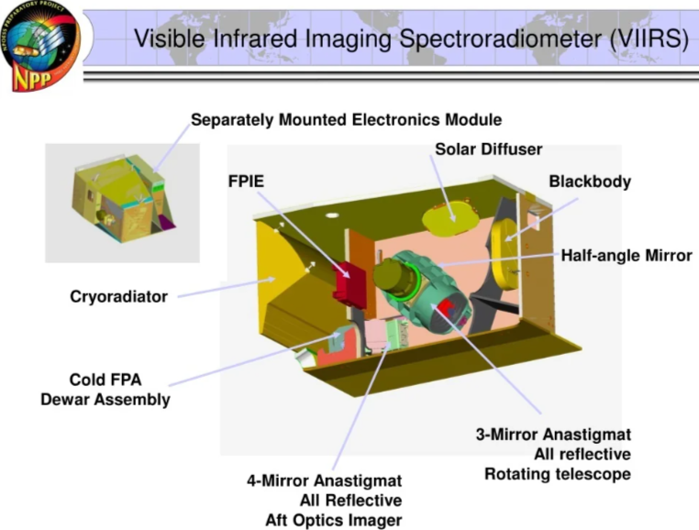
Key facts
Visible Infrared Imaging Radiometer Suite (VIIRS)
Capable of capturing low-light nighttime imagery such as city lights and gas flares (“Black Marble” imagery).
Has 22 spectral bands covering visible to infrared regions.
Provides data for weather forecasting, ocean color, and fire detection.
Detects active fires and thermal anomalies with high accuracy.
Successor to the MODIS instrument with improved spatial resolution and calibration stability.

Slide 48
Types / Satellites Carrying VIIRS
Visible Infrared Imaging Radiometer Suite (VIIRS)
Satellite | Launch Year | Agency | Status | Orbit Altitude | Swath Width | Revisit
Suomi NPP (S-NPP) | 2011 | NASA–NOAA | Active | ~824 km | 3,040 km | Daily
NOAA-20 (JPSS-1) | 2017 | NOAA | Active | ~824 km | 3,040 km | Daily
JPSS-2 (NOAA-21) | 2022 | NOAA | Active | ~824 km | 3,040 km | Daily

Slide 49
Key Features: ➤ Combines high radiometric sensitivity with a wide swath for consistent daily global coverage. ➤ Day/Night Band (DNB) detects low-light emissions (e.g., city lights, aurora, wildfires, gas flares). ➤ Enhanced cloud, aerosol, and ocean color detection capability. ➤ Provides continuity with MODIS and AVHRR for long-term environmental data records. Applications: ▪ Land: Vegetation indices (NDVI, EVI), urban heat mapping, land surface temperature ▪ Ocean: Chlorophyll concentration, sediment, and turbidity ▪ Atmosphere: Cloud detection, aerosol optical depth, volcanic ash tracking ▪ Cryosphere: Snow/ice monitoring, sea ice concentration ▪ Disaster Monitoring: Fire hotspots, flood mapping, dust storms, and nighttime events
Visible Infrared Imaging Radiometer Suite (VIIRS)

Slide 50
Sensor Type: Passive Optical (Visible to Near-Infrared) Platform: ALOS (Advanced Land Observing Satellite) Agency: JAXA – Japan Aerospace Exploration Agency Orbit: Sun-synchronous, near-polar orbit Mission Duration: 2006 – 2011 Altitude: ~692 km Swath Width: 70 km Spatial Resolution: 10 m (across all bands) Viewing Angle: ±30° (pointable off-nadir capability)
Advanced Visible and Near Infrared Radiometer Type-2 (AVNIR-2)
AVNIR-2 AVNIR-2 is a push-broom multispectral imager designed to capture detailed land surface data in visible and near-infrared wavelengths. It succeeded AVNIR (on ADEOS) and was mounted on ALOS (Daichi). The instrument provides high-precision optical data for land cover, coastal mapping, and disaster assessment, complementing ALOS’s radar and PRISM instruments.

Slide 51
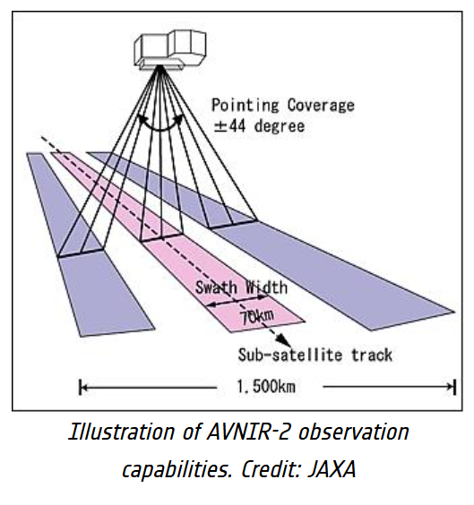
Key facts
Advanced Visible and Near Infrared Radiometer Type-2 (AVNIR-2)
Operates in 4 bands: Blue, Green, Red, and Near Infrared.
Developed by Japan’s JAXA for precise land monitoring and disaster mapping.
Spatial resolution: 10 meters.
Often used with ALOS’s PALSAR radar data for combined optical–radar analysis.
Useful for detecting changes in land use, vegetation, and urban expansion.
Interesting fact: ALOS is nicknamed “Daichi,” which means “Earth” in Japanese.

Slide 52
Key Features High radiometric accuracy and geometric precision for cartographic applications. Forward and backward tilt capability (±44°) allowing repeated observations of the same target for stereo imaging. Data synergy with ALOS’s PRISM (panchromatic stereo mapper) and PALSAR (L-band radar) for integrated land analysis. Enhanced sensitivity to vegetation, coastal waters, and urban areas. Applications Land cover and land-use classification Vegetation monitoring and agriculture assessment Coastal and inland water resource studies Urban and regional mapping Disaster observation (floods, landslides, earthquakes) Integration with digital elevation model (DEM) generation
Advanced Visible and Near Infrared Radiometer Type-2 (AVNIR-2)

Slide 53
Sensor Type: Passive Optical (Visible, Near Infrared, and Shortwave Infrared) Platform: IRS Satellite Series (IRS-1A, IRS-1B, IRS-1C, IRS-1D, Resourcesat-1/2) Agency: ISRO – Indian Space Research Organisation Orbit: Sun-synchronous, near-polar orbit Altitude: ~817 km (IRS-1A/1B) Spatial Resolution: 5.8 m – 72.5 m (varies with version) Swath Width: 23 km – 740 km Mission Timeline: 1988 – Present (continuously upgraded series)
Linear Imaging and Self-Scanning Sensor (LISS) – IRS Series
LISS The LISS (Linear Imaging Self-Scanning) series represents India’s pioneering effort in multispectral Earth observation. Each generation (LISS-I, LISS-II, LISS-III, LISS-IV) improved in terms of spatial, radiometric, and spectral resolution. LISS sensors capture high-quality multispectral imagery across visible, near-infrared (NIR), and shortwave infrared (SWIR) bands.

Slide 54
Key facts
Linear Imaging and Self-Scanning Sensor (LISS) – IRS Series
Developed by ISRO (India), a key instrument in India’s Earth observation program.
Uses push-broom scanning technology.
Multiple versions: LISS-I, II, III, and IV, each improving resolution and spectral range.
Spatial resolution ranges from 23.5m (LISS-III) to 5.8m (LISS-IV).
Commonly used for agriculture monitoring, forest mapping, and rural development.
Interesting fact: LISS-IV provides three-band multispectral imagery with high geometric accuracy, ideal for urban mapping.

Slide 55
Linear Imaging and Self-Scanning Sensor (LISS) – IRS Series
Types of LISS Sensors
Series | Satellite | Resolution (m) | Swath (km) | Spectral Bands (µm)
LISS-I | IRS-1A/1B | 72.5 | 148 | 0.45–0.86 (4 bands: B, G, R, NIR)
LISS-II | IRS-1A/1B | 36.25 | 148 | 0.45–0.86 (4 bands)
LISS-III | IRS-1C/1D / Resourcesat | 23.5 | 141 | 0.52–1.70 (G, R, NIR, SWIR)
LISS-IV | Resourcesat-1/2 | 5.8 | 23 | 0.52–0.86 (G, R, NIR)

Slide 56
Features -Push-broom scanner providing wide-area multispectral coverage. -Designed for resource management, crop monitoring, and environmental studies. -Progressive enhancement from LISS-I to LISS-IV improved radiometric accuracy and ground detail. -Integrated with PAN cameras for panchromatic and multispectral fusion (e.g., IRS-1C, 1D). Operates alongside AWiFS for large-area imaging. Applications 1) Agriculture: Crop type mapping, irrigation planning, yield assessment. 2) Forestry: Canopy density and deforestation monitoring. 3) Water Resources: Reservoir and wetland mapping. 4) Urban Studies: Land use/land cover classification. 5) Disaster Management: Drought, flood, and forest fire monitoring.
Linear Imaging and Self-Scanning Sensor (LISS) – IRS Series

Slide 57
The Charge-Coupled Device (CCD) Camera is the primary multispectral imaging system aboard the CBERS satellites. It provides moderate-resolution imagery across visible to near-infrared bands, supporting environmental, agricultural, and land-use applications. Developed jointly by Brazil and China, the CCD sensor made the CBERS program one of the earliest cooperative Earth observation missions.
CCD Camera – CBERS Series
Sensor Type: Passive Optical (Visible, Near Infrared, Panchromatic) Platform: CBERS Satellite Series Agencies: INPE (Brazil) & CNSA (China) Orbit: Sun-synchronous, near-polar orbit Altitude: ~778 km Swath Width: 113 km Spatial Resolution: 20 m (Multispectral), 5 m (Panchromatic) Mission Timeline: CBERS-1 (1999–2003), CBERS-2 (2003–2007), CBERS-2B (2007–2010), CBERS-4 (2014–Present)

Slide 58
Key facts
CCD Camera – CBERS Series
Joint collaboration between China and Brazil.
The CCD (Charge-Coupled Device) camera captures high-resolution multispectral imagery.
Covers 4 bands: Blue, Green, Red, and Near Infrared.
Spatial resolution: approximately 20 meters.
Used for environmental monitoring, deforestation studies, and land classification.
Interesting fact: CBERS data is open-access, supporting global and regional research efforts.

Slide 59
CCD Camera – CBERS Series
Features
Moderate-resolution imaging for regional environmental studies.
Panchromatic band enables data fusion with multispectral imagery.
Designed for land resource inventory, water management, and agriculture.
Operational on multiple CBERS missions ensuring data continuity.
CBERS-4 version includes improved radiometric calibration and larger dynamic range.
Applications
Agriculture: Crop type mapping, productivity monitoring.
Environment: Land degradation and vegetation change analysis.
Water Resources: Lake and reservoir sedimentation studies.
Urban Mapping: Land use/land cover classification, urban expansion.
Disaster Management: Floodplain monitoring, deforestation tracking.

Slide 60
The Arirang Electro-Optical Imaging Subsystem (AEISS) is a high-resolution multispectral and panchromatic imaging system developed by KARI for the KOMPSAT satellite program. It provides fine-resolution Earth observation data for national mapping, disaster monitoring, and environmental applications. Each generation of AEISS enhanced spatial, radiometric, and spectral precision to support both civil and governmental missions.
Arirang Electro-Optical Imaging Subsystem (AEISS)
Sensor Type: Passive Optical (Visible to Near-Infrared) Platform: KOMPSAT (Korean Multi-Purpose Satellite) Series – KOMPSAT-2, KOMPSAT-3, KOMPSAT-3A Agency: KARI – Korea Aerospace Research Institute Orbit: Sun-synchronous, near-polar orbit Altitude: ~685 km (KOMPSAT-2), ~685–690 km (KOMPSAT-3/3A) Swath Width: 14–15 km Spatial Resolution: 1.0 m (Panchromatic), 4.0 m (Multispectral) Mission Timeline: KOMPSAT-2 (2006–2020), KOMPSAT-3 (2012–Present), KOMPSAT-3A (2015–Present)

Slide 61
Key facts
Arirang Electro-Optical Imaging Subsystem (AEISS)
Developed by South Korea’s KARI (Korea Aerospace Research Institute).
Provides high spatial resolution: 0.5m (panchromatic) and 2m (multispectral).
Designed for urban planning, defense, and disaster management.
Uses optical push-broom imaging technology.
Interesting fact: AEISS can capture color images sharp enough to identify individual vehicles from orbit.

Slide 62
Arirang Electro-Optical Imaging Subsystem (AEISS)
Features
High spatial resolution suitable for urban and precision mapping.
Capable of stereoscopic imaging for 3D terrain model generation.
Enhanced onboard image calibration and noise reduction technology.
Radiometric linearity ensures accurate reflectance data for quantitative analysis.
Used for both civil mapping and defense reconnaissance operations.
Applications
Urban Mapping: Infrastructure planning, change detection, city growth analysis.
Agriculture: Crop health monitoring and yield estimation.
Forestry: Biomass and canopy structure assessment.
Disaster Management: Flood, earthquake, and landslide mapping.
National Security: Border monitoring and reconnaissance imaging.

Slide 63
PlanetScope camera
Sensor Name | Vehicle | Resolution |  |  |  | Wavelength (µm) | Swath width (km)
 |  | Spatial | Spectral | Temporal | Radiometric
PlanetScope Camera (USA) | PS2 (DOVE-C) (2014-2022) | 3.0-4.1 m | 4 Bands | 1 Day | 12 Bits | 0.455-0.860 | 25-32
 | PS2.SD (DOVE-R) (2019-2022) |  |  |  |  | 0.464-0.888
 | PSB.SD (SuperDOVE) (2020-Present) | 3.7-4.2 m | 8 Bands |  |  | 0.431-0.885
SkySat Camera
Sensor Name | Vehicle |  | Resolution |  |  |  | Wavelength (µm) | Swath width (km)
 |  |  | Spatial | Spectral | Temporal | Radiometric
SkySat Camera (USA) | SkySat Contellation (2013-Present) (21 Satellites) No. of Sensors: 03 | SkySat 1-2 | Pan; 0.86m MS; 1m | 5 Bands | 4-5 Days | 16 Bits | 0.45-0.9 | 8
 |  | SkySat 3-15 | Pan; 0.65m MS; 0.81m |  |  |  |  | 5.9
 |  | SkySat 16-21 | Pan; 0.57m MS; 0.75m |  |  |  |  | 5.5

Slide 64
Remote Sensing Instrument (RSI)
Sensor Name | Vehicle | Resolution |  |  |  | Wavelength (µm) | Swath width (km)
 |  | Spatial | Spectral | Temporal | Radiometric
Remote Sensing Instrument (Taiwan) | FORMOSAT-2 (2004-2016) No. of Sensors: 02 | Pan; 2m MS; 8m | 5 Bands | 1 Day | 8 Bits | 0.45-0.9 | 24-62
Vegetation Monitoring Instrument (VMI)
Sensor Name | Vehicle |  | Resolution |  |  |  | Wavelength (µm) | Swath width (km)
 |  |  | Spatial | Spectral | Temporal | Radiometric
Vegetation Monitoring Instrument (France & Europe) | SPOT-4 (1998-2013) | 04 (HRVIR (2), VMI, DORIS) | 1.15 km | 4 Bands | 1 Day | 8-10 Bits | 0.43-1.75 | 2250
 | SPOT-5 (2002-2015) | 04 (HRG (2), HRS, VMI)
 | PROBA-V (2013-2020) | 01

Slide 65
GeoEye Imaging System
Sensor Name | Vehicle | Resolution |  |  |  | Wavelength (µm) | Swath width (km)
 |  | Spatial | Spectral | Temporal | Radiometric
GeoEye Imaging System (USA) | GeoEye-1 (2008-Present) | Pan; 0.41m MS; 1.64m | 5 Bands | ≤ 3 days | 11 Bits | 0.45-0.92 | 15.2
High Resolution Imager (HiRI)
Sensor Name | Vehicle | Resolution |  |  |  | Wavelength (µm) | Swath width (km)
 |  | Spatial | Spectral | Temporal | Radiometric
High Resolution Imager (HiRI) (France) | Pleiades 1A (2011-Present) | Pan; 0.5m MS; 2m | 5 Bands | 1 Day | 12 Bits | 0.48-0.94 | 20-53
 | Pleiades 1B (2012-Present)

Slide 66
Application of Sensors
Name of Sensors | Special Applications | Common Applications
PlanetScope Camera | Mining: land reclamation, Slope monitoring | Agriculture – Crop health monitoring, precision farming, yield estimation. Forestry – Deforestation detection, forest health and biomass assessment. Environmental Monitoring – Tracking floods, droughts, pollution, and land degradation. Disaster Monitoring/Management – Assessing and mapping natural disasters like floods, landslides, and fires. Land Use / Land Cover Mapping – Identifying changes in urban areas, vegetation, and surface features.
SkySat Camera | Urban planning, Infrastructure monitoring, Defense & security,
GeoEye Imaging System | High-precision mapping & surveying, Defense & intelligence operations.
High-Resolution Imager | Geological mapping, Disaster management
Remote Sensing Instrument | Urban/regional planning, Water resources management, Detailed mapping
Vegetation Monitoring Instrument | Crop yield prediction, Drought detection, Vegetation health monitoring

Slide 67
Thank you for your attention

